Slide 1
Types
int, float, string, rune, bool
len, concat, strconv, conversion, assertion
math, rand, docs

Slide 2
statically typed

Slide 3
types
statically typed
languages like javascript are dynamically typed
this a big difference between golang (statically typed) and other languages that are dynamically typed
strong typing / static typing helps prevent errors

Slide 4
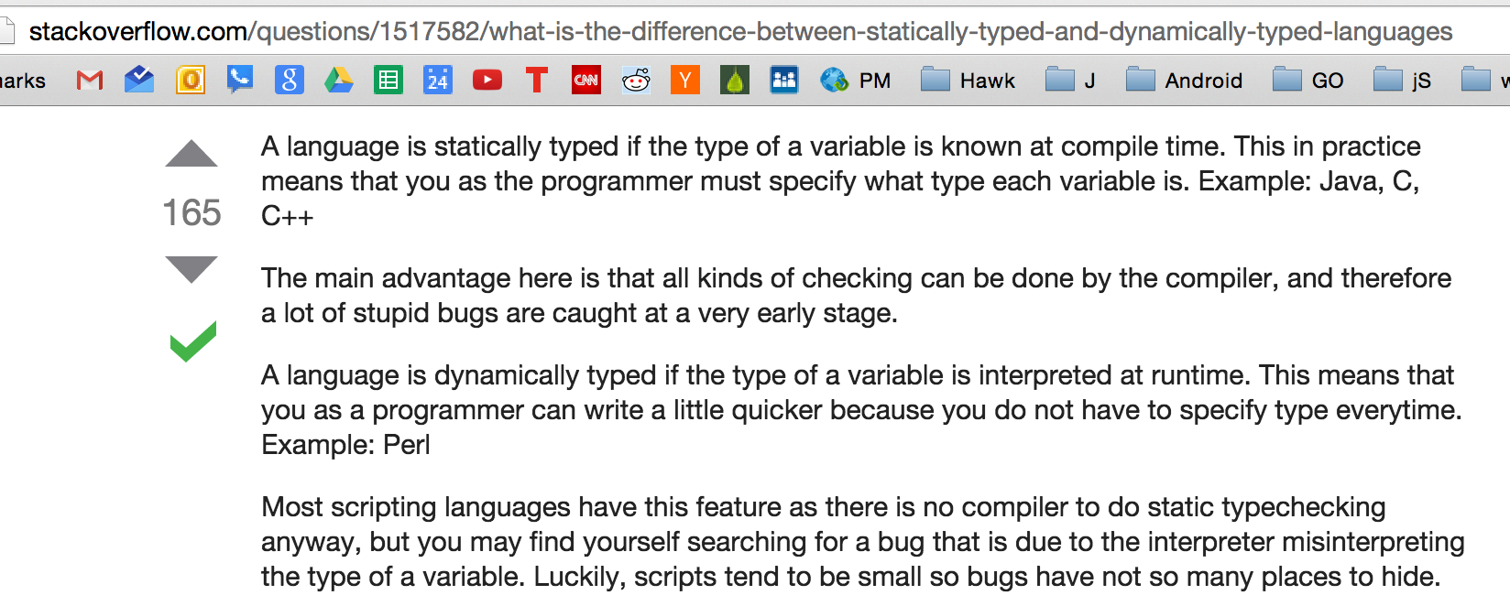

Slide 5
viewing type

Slide 6
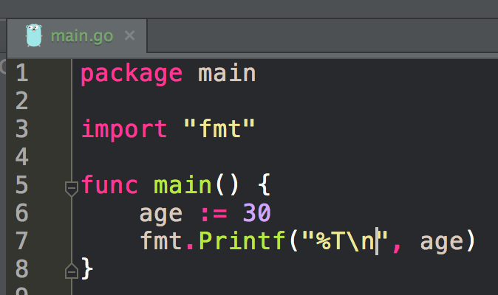
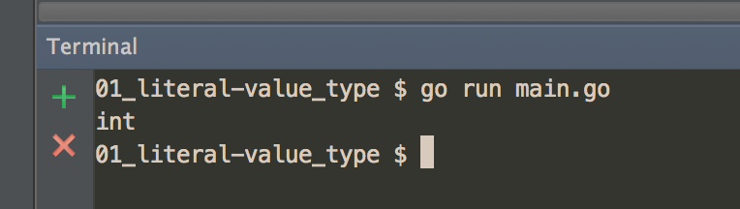

Slide 7
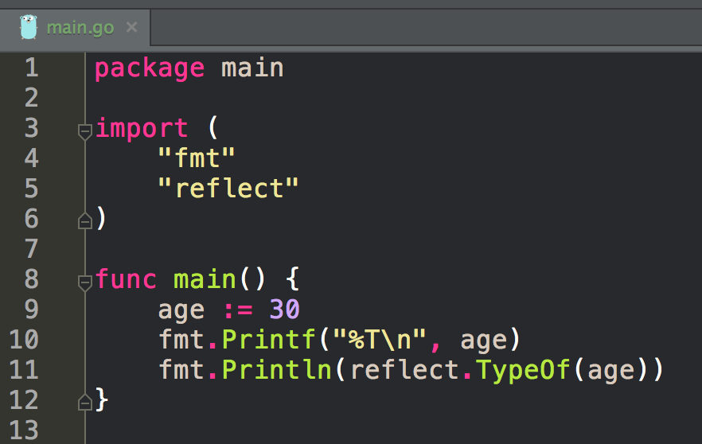
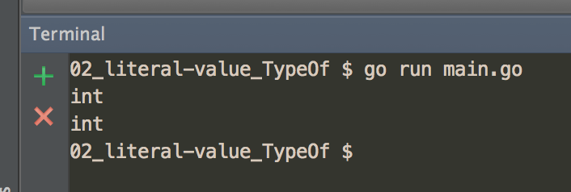

Slide 8
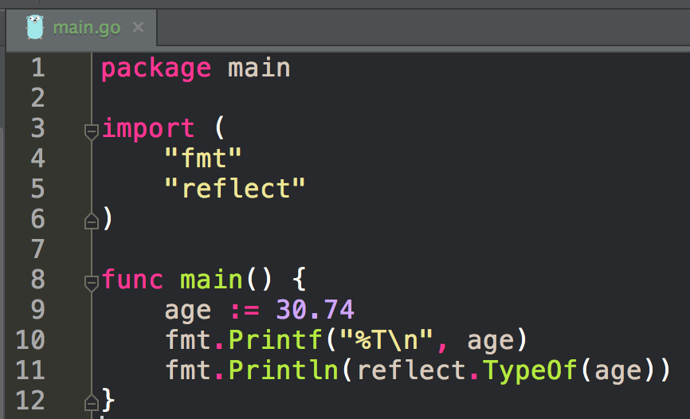
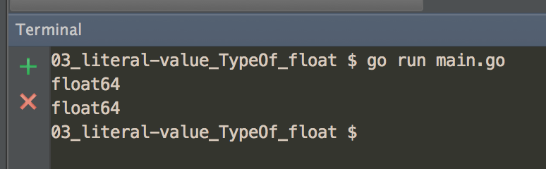

Slide 9
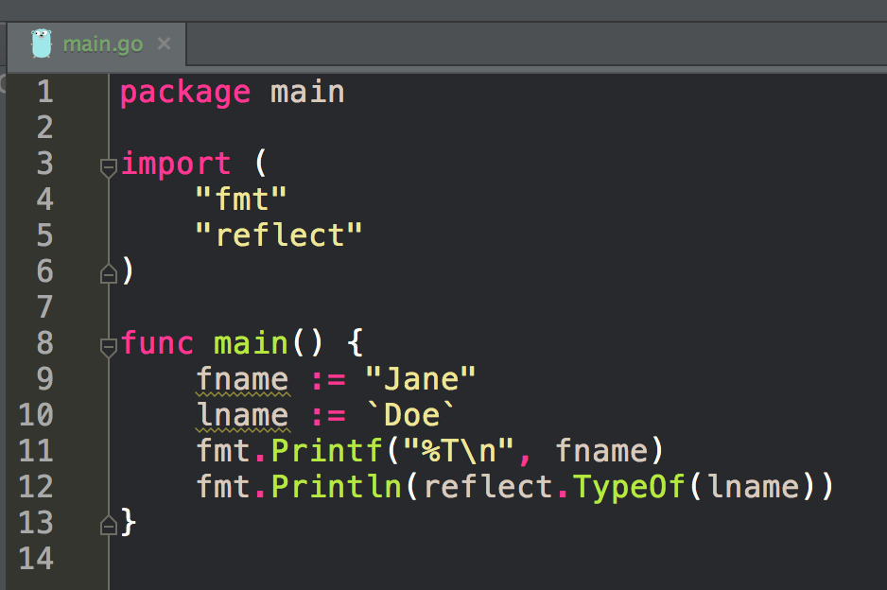
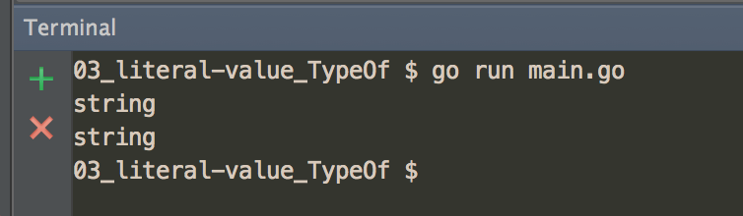

Slide 10
question
what does this represent:
00001010

Slide 11
Answer
we don’t know until we know the type:
is it base 2 int?
is it a color?
is it a code point?

Slide 12
type: size & representation

Slide 13
Type
Provides the compiler with two pieces of information:
size
representation

Slide 14
Type
Provides the compiler with two pieces of information:
size
how much memory to allocate
representation
what the memory represents

Slide 15
float64
gives you two pieces of information
size: 64 bits
representation: float

Slide 16
int
architecture specific
size: “word” size - 4 or 8 bytes (eg, 32 or 64 bits)
representation: int

Slide 17
[256]int
size: 256 bytes
representation: int

Slide 18
[256]bool
size: 256 bytes
representation: bool

Slide 19
[256]byte
size: 256 bytes
representation: byte

Slide 20
language spec

Slide 21
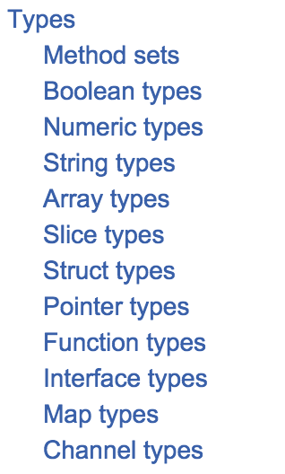
https://golang.org/ref/spec

Slide 22
boolean

Slide 23
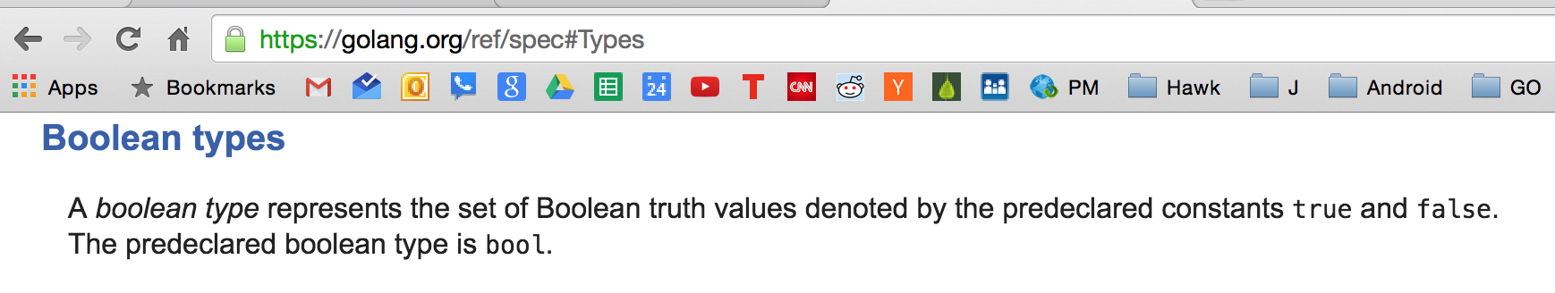

Slide 24
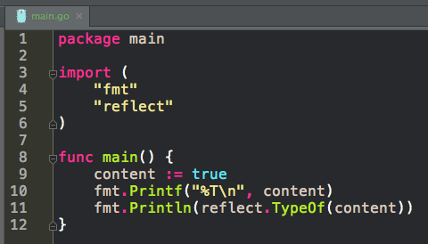
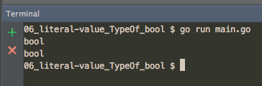

Slide 25
numeric

Slide 26
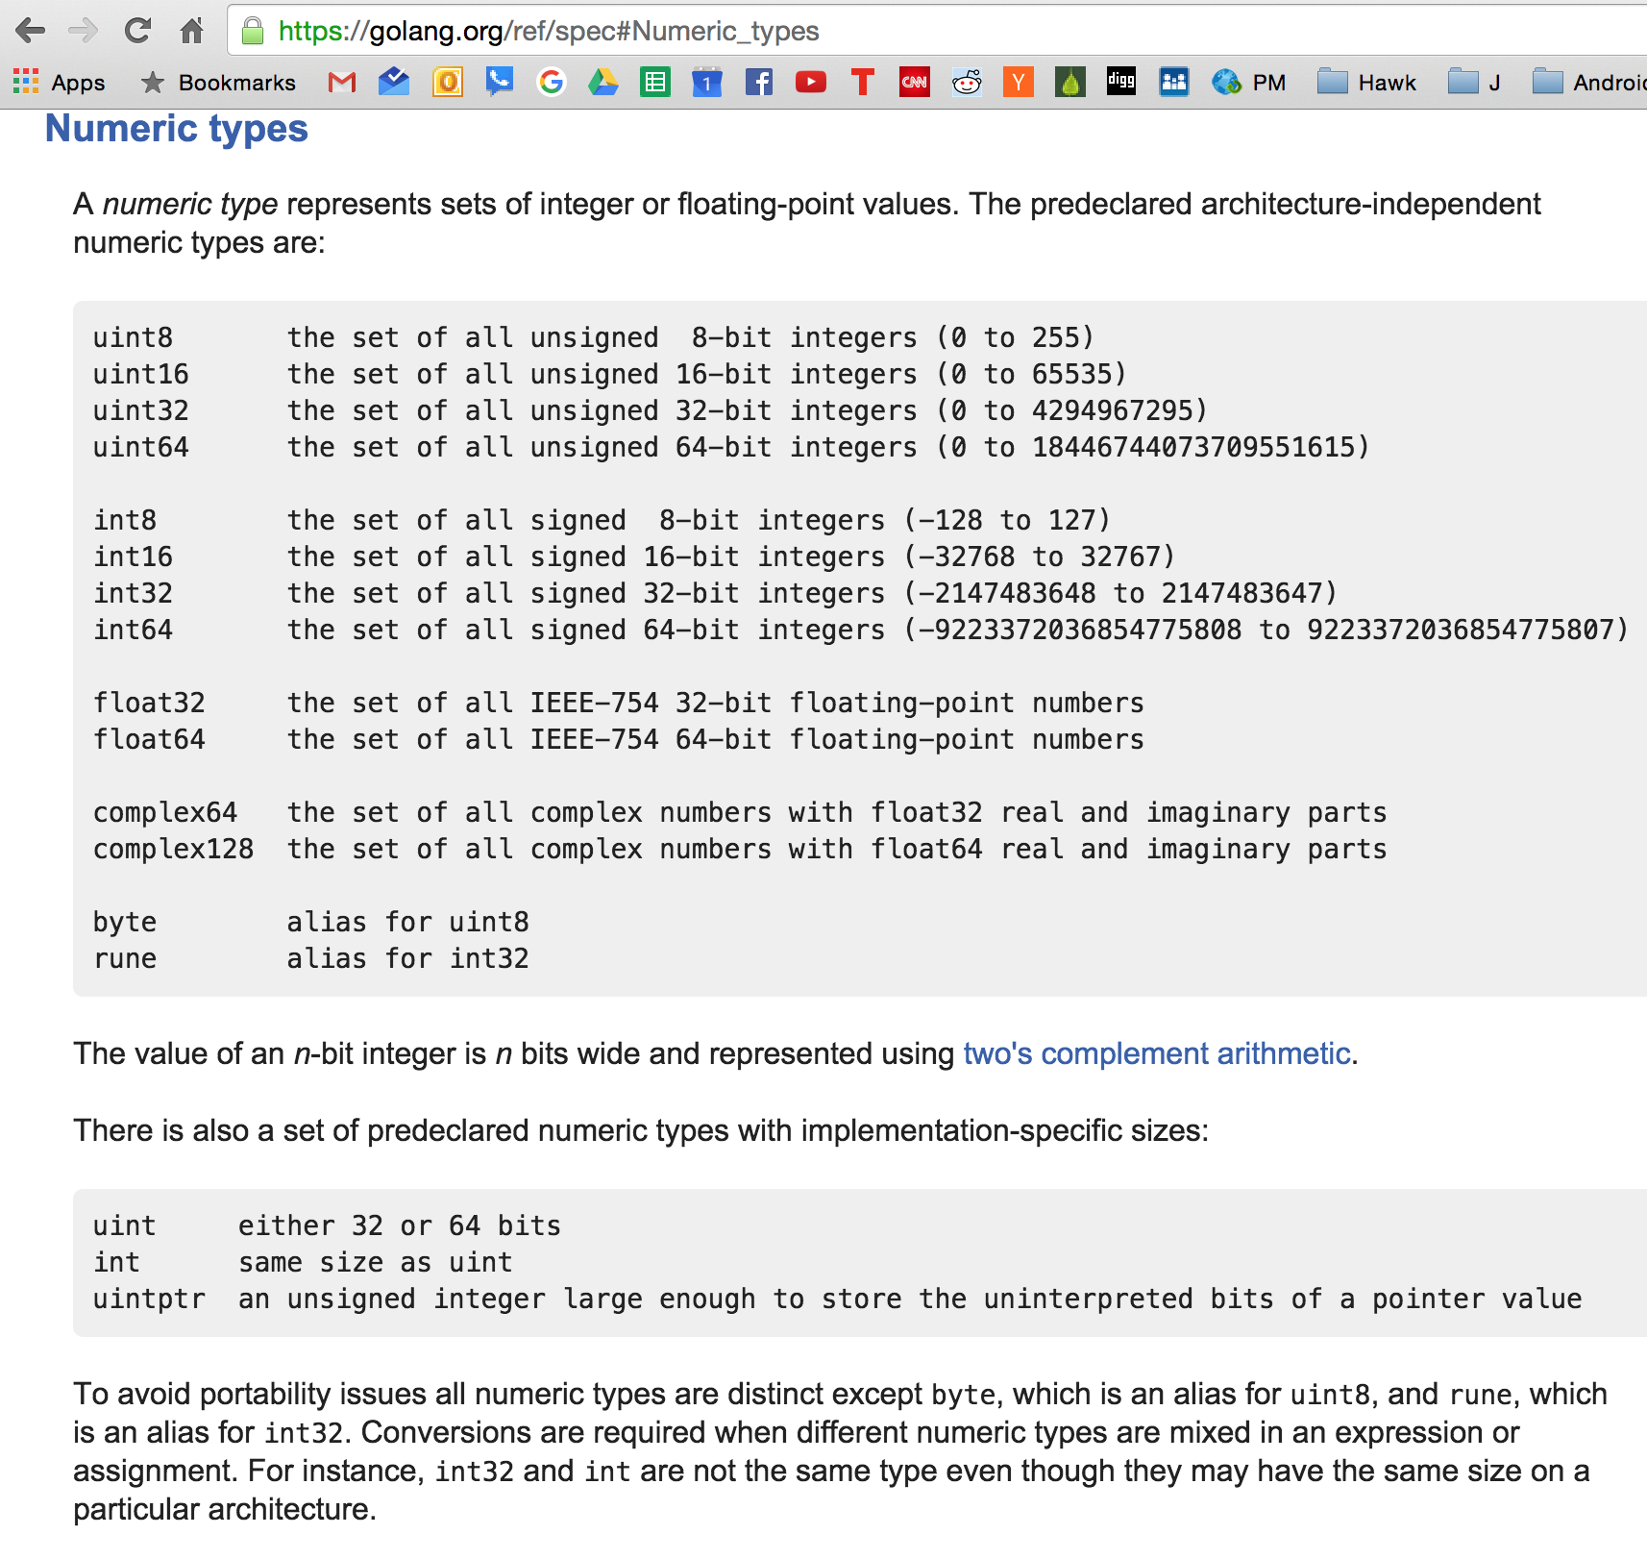
u - unsigned
meaning, no negative (-) values, only positive (+) values
eg, it has no sign to say positive/negative, they’re all just positive;
that’s why you have twice as many as signed
determined by your cpu word size: 32bit or 64bit
use “int” unless you have hardware reasons to use “int8” or “int16”

Slide 27
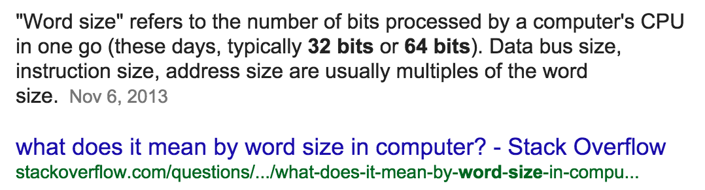
u - unsigned
meaning, no negative (-) values, only positive (+) values
eg, it has no sign to say positive/negative, they’re all just positive;
that’s why you have twice as many as signed
determined by your cpu word size: 32bit or 64bit

Slide 28
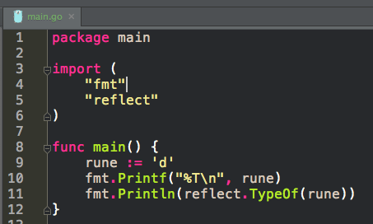
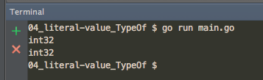
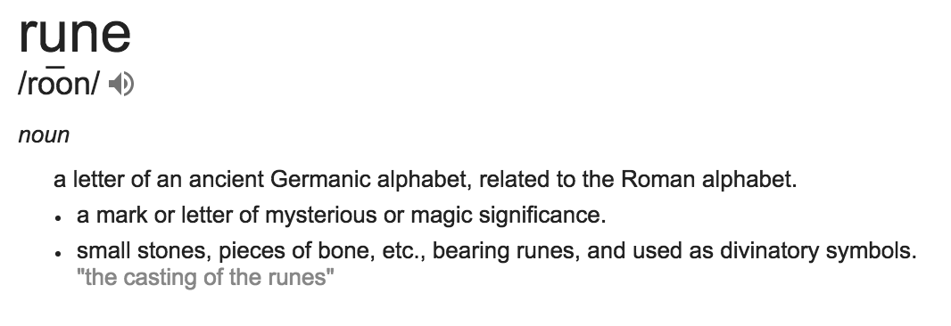
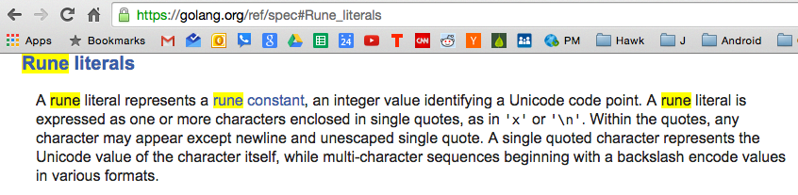
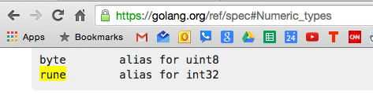

Slide 29
rune is an alias for int32
because UTF-8 is 4 bytes

Slide 30
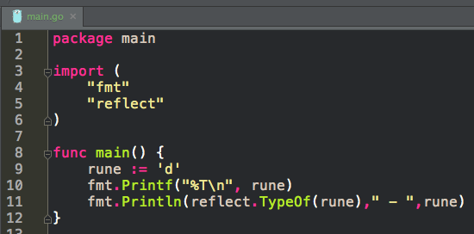
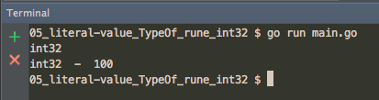

Slide 31
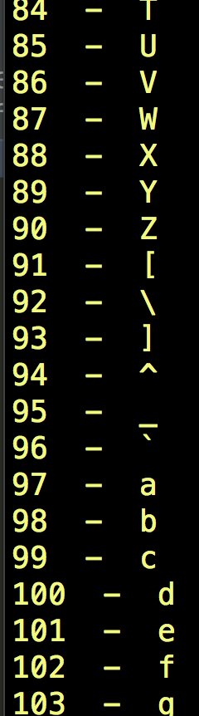
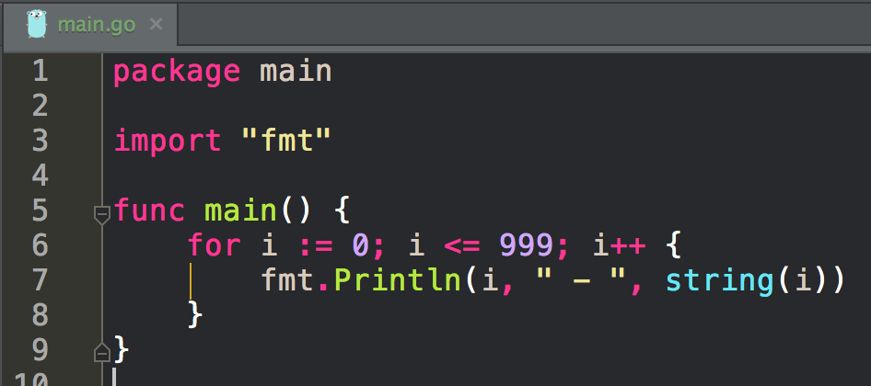
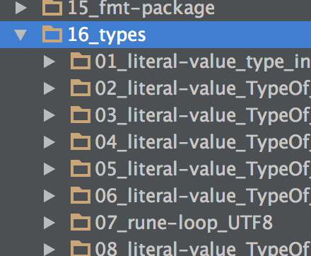

Slide 32
string

Slide 33
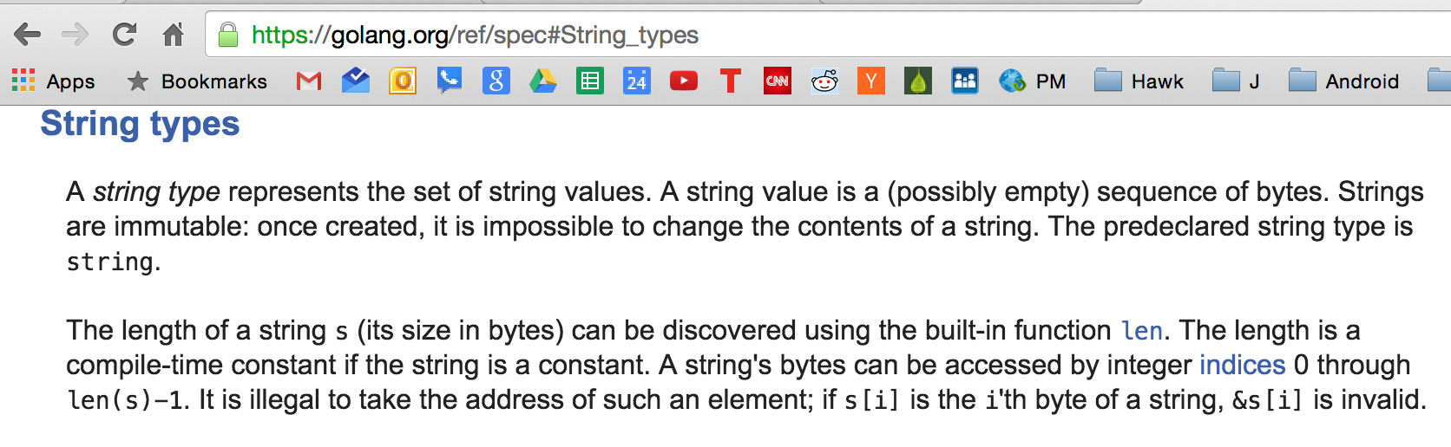

Slide 34
string
0x8201e02f0
len
built-in type
also a reference type
reference types are very important
string is a two word data structure
either 8 or 16 bytes
32 bit architecture: 4 bytes (32 bits) per word * 2 words = 8 bytes
64 bit architecture: 8 bytes (64 bits) per word * 2 words = 16 bytes
first word
pointer to array of bytes
second word
len of those bytes
all reference types have a pointer
when we copy a string
we are making a copy of the two words:
word 1: the pointer to the underlying array of bytes
word 2: the length
strings are immutable
zero value for a string
word 1: nil
a pointer set to the value of zero is nil
word 2: 0
byte
byte
byte
byte
byte
byte
byte
byte
byte

Slide 35
string
string
series of characters
UTF-8 encoding
ASCII is a 7 bit character series
128 letters
UTF-8 are those same 7 bits, multiple bytes for other characters
UTF-8 is a multiple byte character encoding
other characters could be two bytes, or three bytes, or four bytes per character
chinese characters will probably be four bytes per character;
golang uses UTF-8 because Rob Pike & Ken Thompson were partially inventors of UTF-8
create a string:
double quotes || backticks
backticks can be multiple lines
escape sequences
strings support escape sequences like \n for newline or \t for a tab

Slide 36
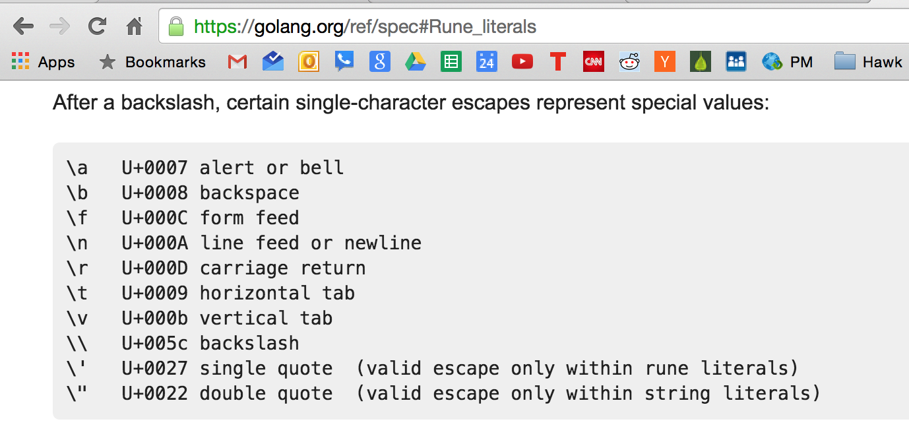
escape sequences

Slide 37
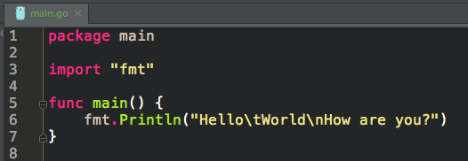
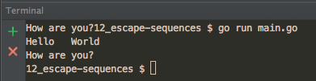

Slide 38
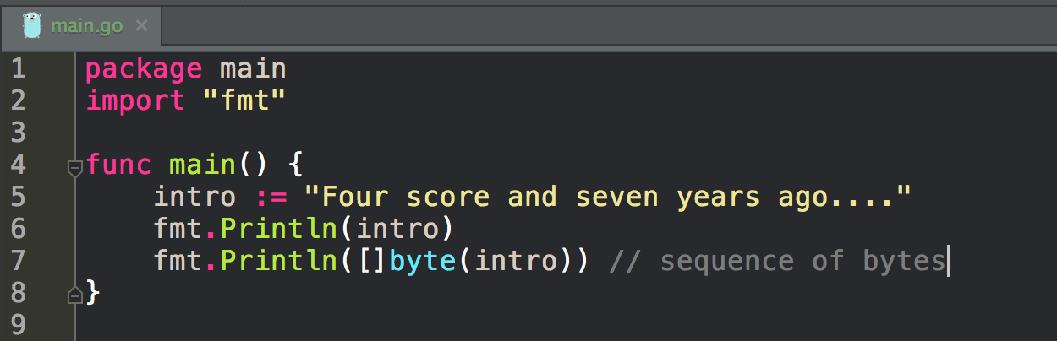
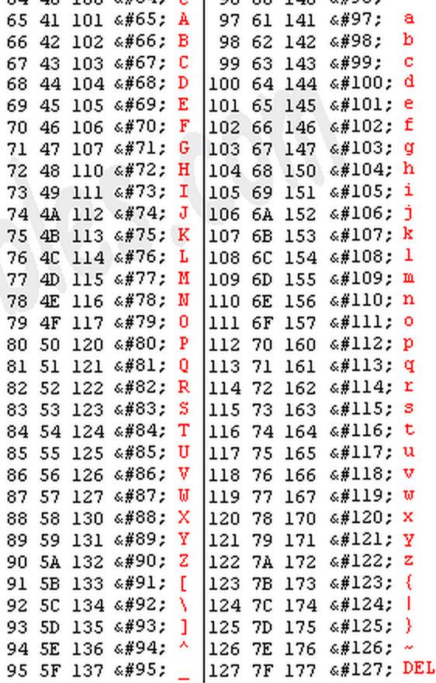
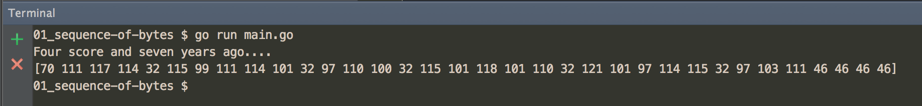
UTF-8
ASCII
conversion

Slide 39
string
len
len gives us the number of bytes, not the number of characters

Slide 40
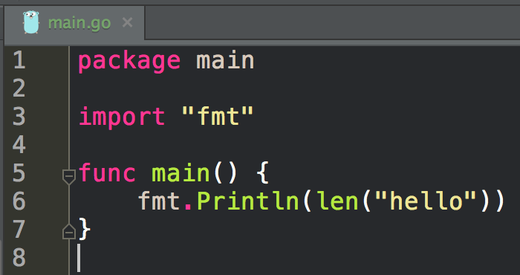
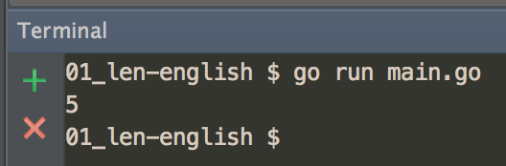

Slide 41
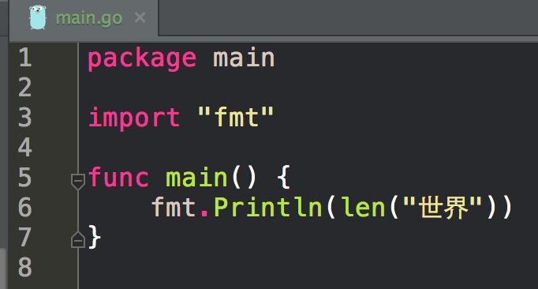
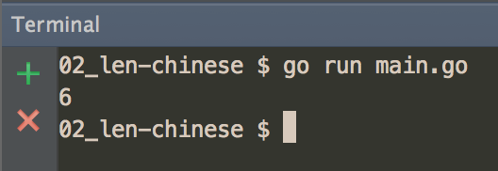

Slide 42
string
index

Slide 43
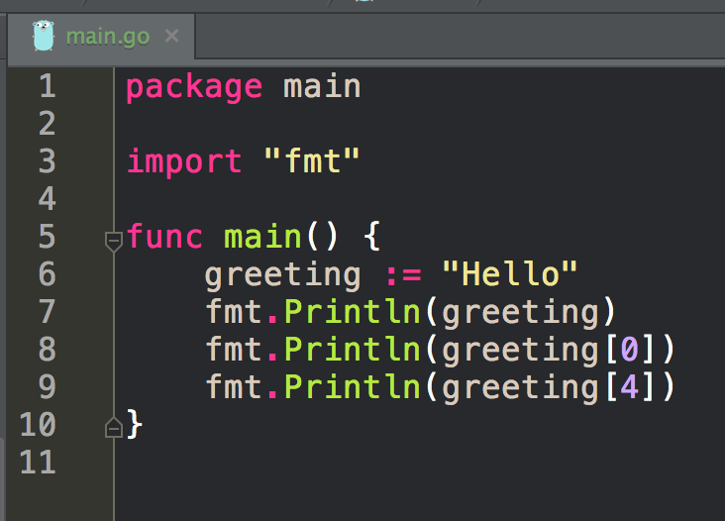
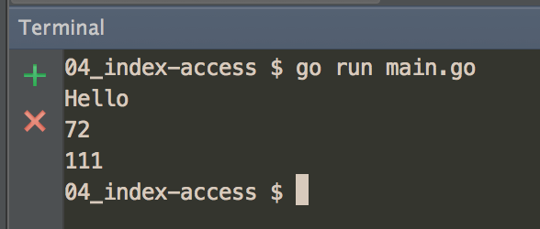
UTF-8
ASCII
index

Slide 44
string
slicing

Slide 45
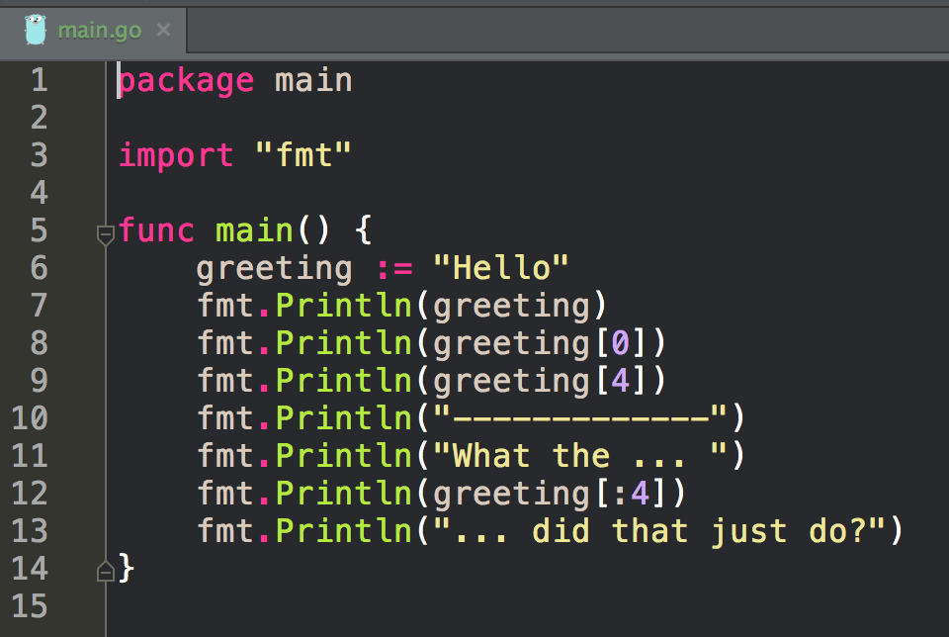
What is this going to print?

Slide 46
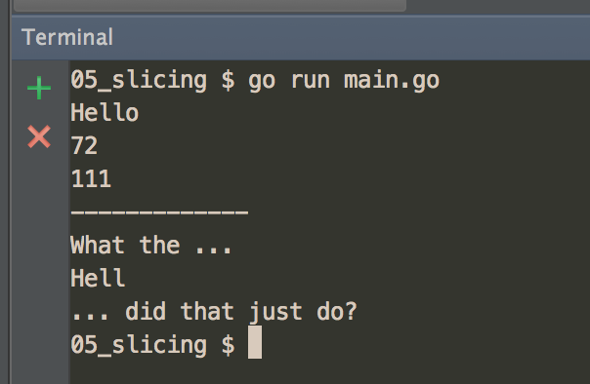

Slide 47
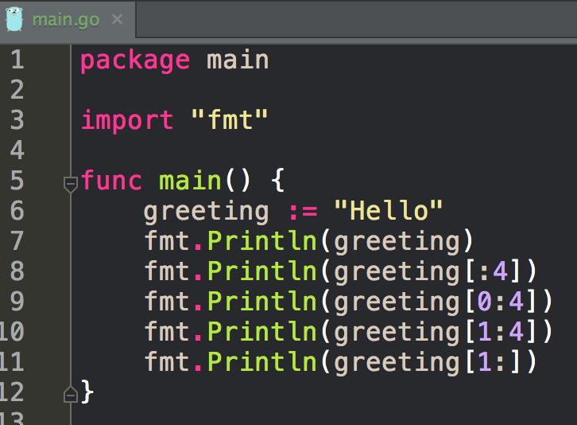
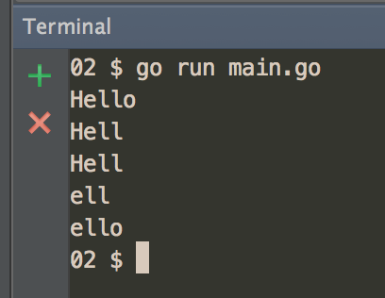
H e l l o
0 1 2 3 4
slicing

Slide 48
string
concatenation

Slide 49
+

Slide 50
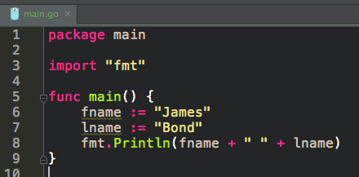
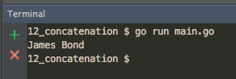

Slide 51
exercise
create a program that uses these escape sequences:
\t \n

Slide 52
exercise
create a program that uses len

Slide 53
exercise
create a program that using an index to access a rune in a string

Slide 54
exercise
create a program that slices a string

Slide 55
exercise
create a program that concatenates two variables both of type string

Slide 56
strconv package
The most common numeric conversions are Atoi (string to int) and Itoa (int to string).

Slide 57
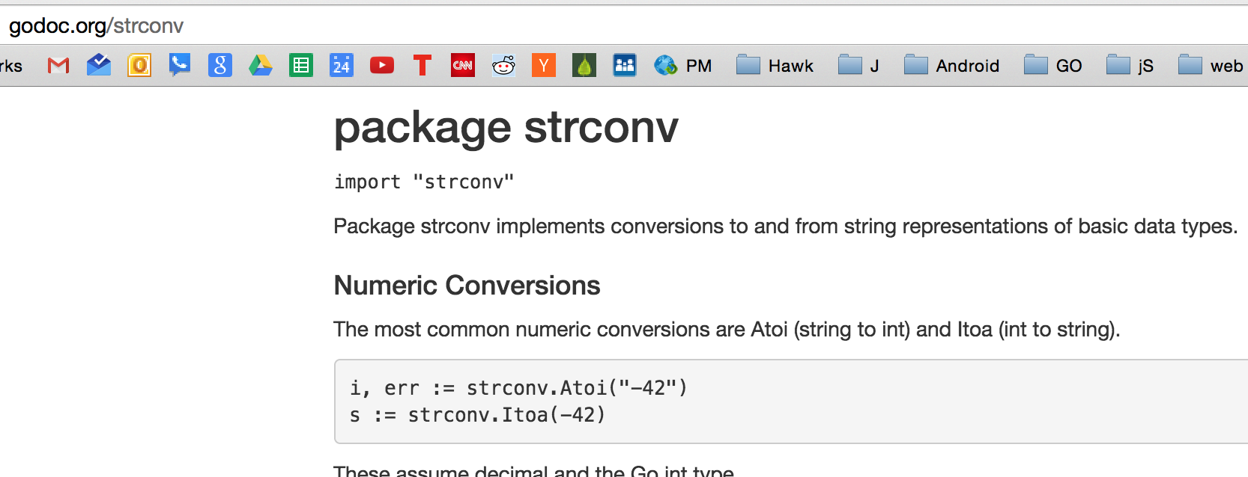

Slide 58
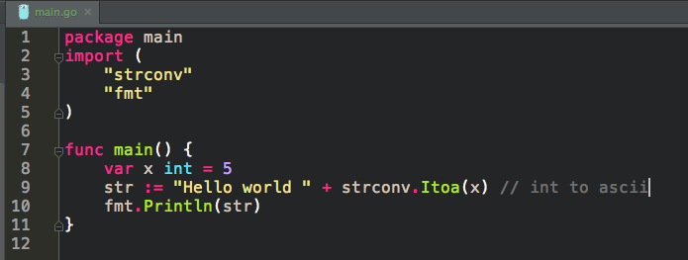
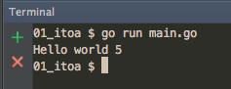

Slide 59
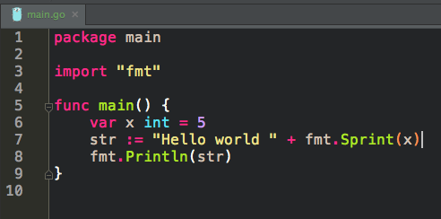
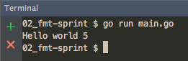
You can also convert an int to string
like this
Let’s look up fmt.Sprint to see how it converts an int to a string

Slide 60
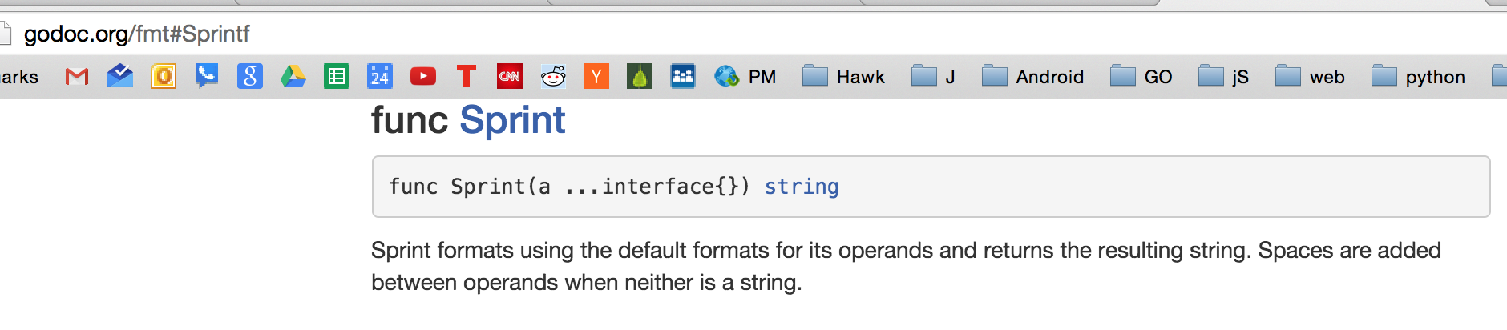

click the name of the func
and you are taken to the source code
This takes you into reading even more source code:
What is a newPrinter()?
Does the conversion / assertion occur in doPrint?
Is the conversion string(p.buf)?
These are good questions, and digging in the source code trying to understand it will build your skills and familiarity with the language.
At a certain point, you just say, “Ok, fmt.Sprint will convert an int to a string”
At a certain point, you have to accept abstraction.
“If you wish to make apple pie from scratch, you must first create the universe”
~ Carl Sagan

Slide 61



Slide 62
exercise
create a program that uses Atoi & Itoa

Slide 63
conversion
known as casting in some languages

Slide 64


Slide 65

for you, dear student, to read on your own ….

Slide 66



Slide 67



Slide 68



Slide 69



Slide 70



Slide 71
exercise
create a program that converts int to float64

Slide 72
exercise
create a program that converts float64 to int

Slide 73
exercise
create a program that converts []byte to string

Slide 74
exercise
create a program that converts string to []byte

Slide 75
assertion
conversion - change one type to another
assertion - used for interfaces

Slide 76
assertion
conversion - change one type to another
assertion - used for interfaces
We will learn more about interfaces.
As you gain exposure to them, you will gain understanding.

Slide 77


Already Saw This
notice x is of type interface{}

Slide 78

assertions
are for interface types
dynamic type
even though go is statically typed
we can use interfaces to create dynamic typing

Slide 79


Slide 80


name is not of type interface{}
assertions
are for interface types

Slide 81


assertions
are for interface types

Slide 82



Slide 83


What will happen when I uncomment line 8 and run this?

Slide 84



Slide 85



Slide 86


reminder:
casting

Slide 87


can we cast
type interface?

Slide 88
BACK TO TYPE

Slide 89
https://golang.org/ref/spec

Slide 96
math package

Slide 97


Slide 98



Slide 99
exercise
rounding up
create a program that asks the user for a float64 and assigns it to x
then print the least integer value greater than or equal to x
for example, if someone entered 43.2, print: 44
for example, if someone entered 43.9, print: 44
use the math pkg func Ceil

Slide 100
reading docs
an exercise ...

Slide 101
exercise
how would you learn about
TypeOf

Slide 102



Slide 103


Slide 104


Slide 105


Slide 106


Slide 107

Will go help help?

Slide 108
Will go help help?
no.

Slide 109
true or false
godoc at the terminal can bring up
the documentation for the reflect package

Slide 110


Slide 111
exercise
bring up the documentation for
reflect TypeOf
in terminal

Slide 112


Slide 113

case sensitive

Slide 114

remember this syntax

Slide 115

here is another example
remember this one?

Slide 116
Review
boolean
true
false
numeric
int
uint
float64
string
“”
``
escape sequences
sequence of bytes
immutable
len
index access rune
“hello”[0]
slicing
“hello”[:4]
concatenate
+
strconv
Atoi
Itoa
conversion
T(x)
Type(variable)
string(‘a’)
string([]byte{'h', 'e', 'l', 'l', 'o'})
[]byte(“Hello”)
float64(12)
int(12.1230123)
assertion
used for interface types
math package
reflect package
TypeOf

Slide 117
Review Questions

Slide 118
static vs dynamic
What is the difference between a statically and dynamically typed language?

Slide 119
static vs dynamic
Is golang statically or dynamically typed?

Slide 120
static vs dynamic
What type is like dynamic typing in golang?

Slide 121
rune
In your words, provide a definition for rune.
What is a rune in golang?
Why is a rune an alias for int32 as opposed to int64 or uint32?

Slide 122
unsigned
What is the difference between int & uint?

Slide 123
string index access
Write a program that
create a string variable and assigns it some value
access a rune within the string variable using an index
prints this
slices the string
prints this

Slide 124
conversion
Write a program that demonstrates these conversions
Type(variable)
string(‘a’)
string([]byte{'h', 'e', 'l', 'l', 'o'})
[]byte(“Hello”)
float64(12)
int(12.1230123)

Slide 125
assertion
Write a program that demonstrates assertion

Slide 126
int and uint
What determines whether or not int and uint are 32 or 64 bytes?

Slide 127
type
Create a program that displays a variables type using both
TypeOf
%T (a formatting verb used with Printf)

Slide 128
rand package
We haven’t talked about the rand package yet, however …
go read about the rand package on godoc.org
look at the example code for “magic eight-ball”
describe what rand.Seed(42) does
in your own words, what does “initialize the generator to a deterministic state” mean?
What does it mean to seed a random number generator?
(you might need to google this)
what happens when you change the value from 42 to some other value?
can rand.Seed(42) take a float64?
describe what rand.Intn(len(answers)) does

